Slide 1


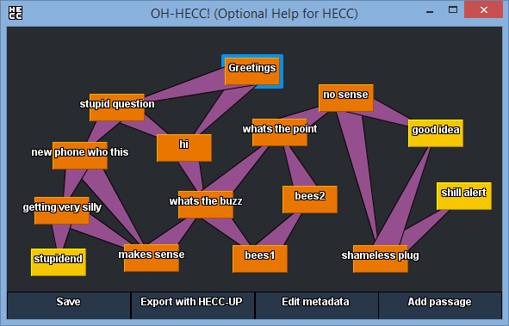
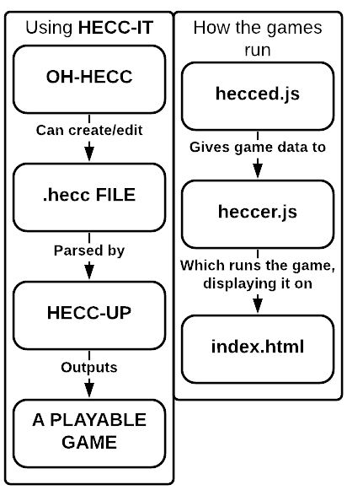

Hypertext Game Project
HECC-IT!
Rachel Lowe (Supervisor: Dr Richard Bartle)
WHAT IS HECC-IT?
Hypertext Editing and Creation Code Integrated Toolkit is the hypertext game authoring tool made for indecisive people.
Most existing systems require users to use a GUI or to write raw code and hope it compiles. However, no tools truly offer users the choice between the two (or, if they do, it’s with some caveats).
But not HECC-IT.
You’re a power user who doesn’t want to faff around with a GUI? You can just write .hecc code! You’re a casual user who wants a GUI? You can use OH-HECC!
Then, once that’s done, just put it through HECC-UP and you have your playable HECC-Infused Nice Game!
HECC-IT is a standalone desktop application, written in Java, so users only need to download it and run it.
Games made with HECC-IT are in a client-side HTML/JavaScript format, so anyone with a web browser can play them, anytime, anywhere, without any hassle.
HOW DOES IT WORK?
HECC-IT is a toolkit, within a single executable .jar file.
Users open the executable, pick an existing .hecc file (or make one), and are then given the choice to export it now or keep editing it (and export later).
Once exported, users can just open the index.html page, and they can play the game!
HOW WAS IT MADE?
The first part of HECC-IT to be produced was the output. I made a very simple hypertext game in HTML/JS, which simply replaced the text displayed on part of the HTML page in response to the player clicking on special links in the content.
The next step was creating the .hecc language (a simple declarative language to declare passages and links), before making HECC-UP, which converts .hecc code into playable games.
Following this, I made OH-HECC, which can read .hecc files, display them as a network of linked passages, allow the user to edit them, and save the edited .hecc file.
With the tool made, I proceeded to start authoring a proper hypertext game: Backblast; a murder mystery where you are the victim.
I have been adding further features to HECC-IT since then, such as conditional statements/ guard conditions, markdown formatting, and extra usability features for authors.
Above: A screenshot of OH-HECC (Optional Help for HECC; the editing GUI) showing the network of passages for an example game. (Backblast was too big to fit on this poster)
Below: A screenshot from that game after exporting it with HECC-UP (HECC Ultra Parser).
If you want to play some of the games produced during the development of HECC-IT, to see for yourself what it can do, you can play them here:
https://11belowstudio.itch.io/the-hecc-it-demo
Notes:
Stuff to add: Sample .hecc code?
Discuss the game I’m writing?
Maybe work out how to put animations in the ppt
Post one of the example games onto my itch.io page, put a link to it in the powerpoint?

